Slide 1

Government College of Engineering and Research Avasari, Pune
Department of
Instrumentation and Control Engineering
Simulation and Development of Robotic Arm using Matlab and Simulink
Presented by
Manohar Ravindra Dagade

Slide 2
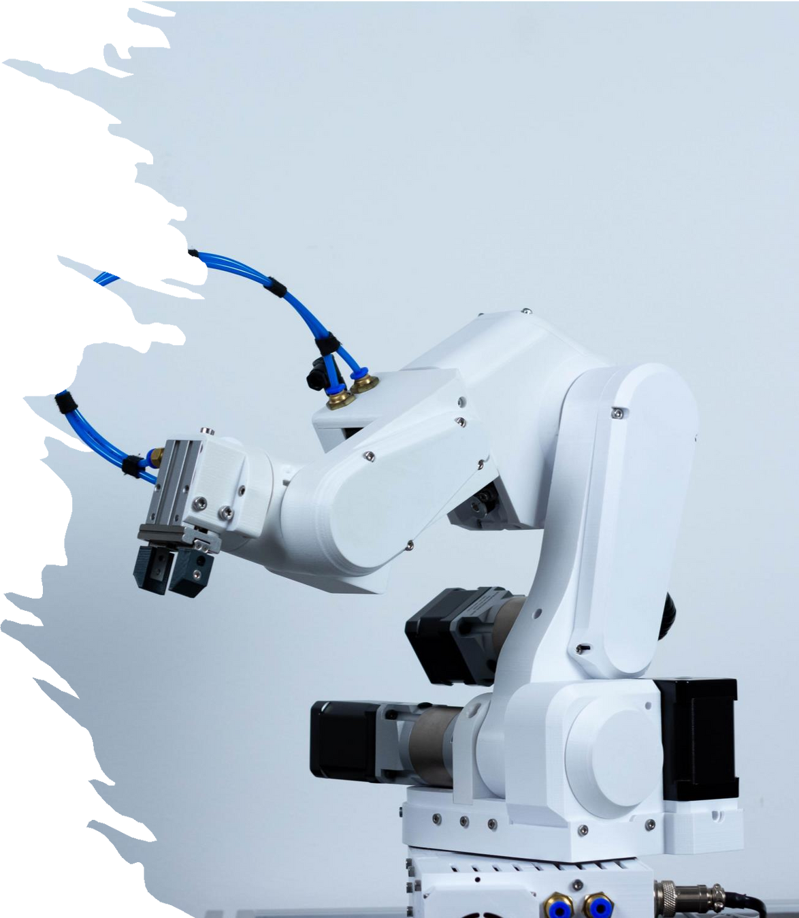
Content:
Introduction
Robotic Arms
About Project
Project
Designing in SolidWorks
Importing in Simulink
Giving Input to Actuators
Control Strategy
Future Work and Improvements
Conclusion
Question and Answer

Slide 3
Introduction of Robotic Arm
Definition: Programmable mechanical devices that replicate the motion
and functions of a human arm.
Structure: Composed of interconnected links and joints, enabling a wide range of movements.
Degrees of Freedom (DOF): Typically designed with multiple DOF, allowing for complex and precise tasks.
Applications: Widely used in industries such as manufacturing, medical
surgery, and research.
Tasks Performed: Capable of operations like welding, assembly,
material handling, and precision tasks in medical fields.
Significance in Simulation: Simulation helps in optimizing design and
control strategies before real-world deployment.
Advancements: Integration with AI and advanced control algorithms for smarter and more autonomous functionalities

Slide 4
Project
Objective: The project aims to develop and simulate a 5-DOF robotic arm using MATLAB and Simulink.
Approach: The robotic arm was first designed in SolidWorks, then imported into Simulink for simulation and control.
Software Tools: Utilizes SolidWorks for mechanical modeling and MATLAB/Simulink for simulation and control design.
Control Strategy: Manual control of each joint is implemented using sliders to allow 360-degree rotation.
Simulation Purpose: Enables testing and analysis of the arm's motion, control strategies, and overall system behavior in a virtual environment.

Slide 5



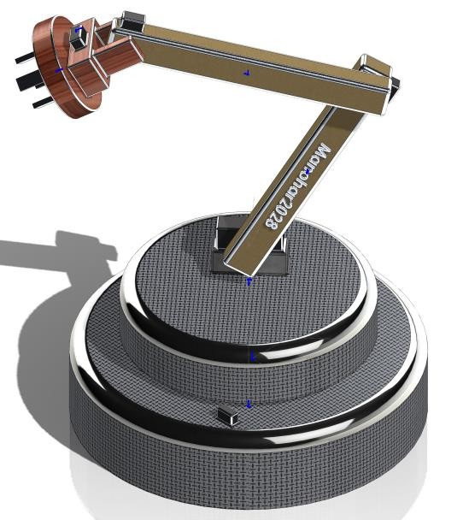
Designing in Solidworks
Each element of arm is designed in Solidworks
It is purposely designed for simulation so no mechanical detailed are carried out
Each part is designed individually and then assembled it as like we do in hardware.

Slide 6
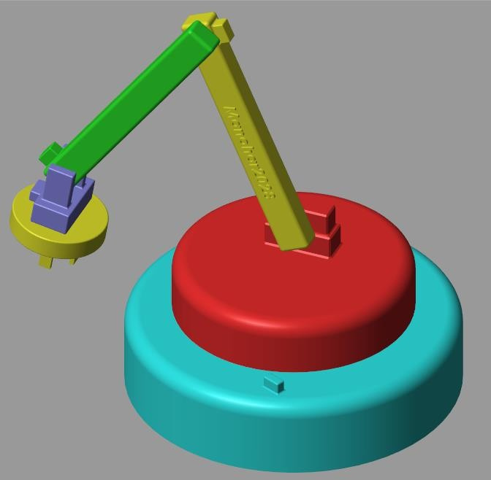
Importing Robotic arm in Simulink
Model Import: The robotic arm was imported into Simulink using the Simulink- SolidWorks Plug-In.
Integration Tool: This plug-in facilitates a seamless transfer of CAD models from SolidWorks into the Simulink environment.
Simulation and Control: Enables direct incorporation of detailed mechanical designs for simulation and control system development in Simulink.

Slide 7
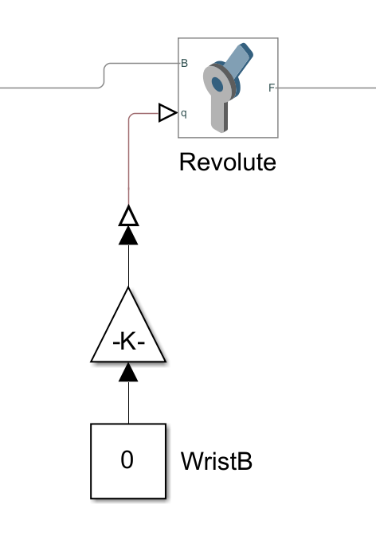
Inputs to joints
This robotic arm consists of 6 Dof
Between each link there is a revolute joint which allows rotation of links
Various parameters can be observed and
monitored through revolute joints.
We can give motion as well as torque
input to joint depending of need
Furthermore we can see angular position, angular velocity
Here motion input is given in order to calculate torque

Slide 8
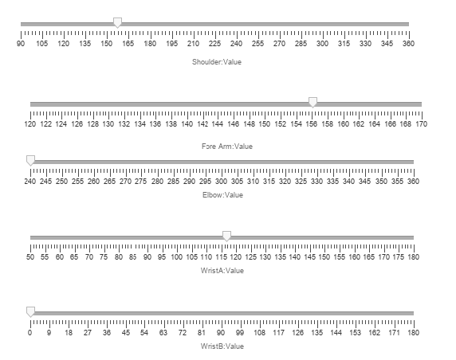
Controls
Each link's joint is control using sliders
Each slider has been given a specific limit so that the arm will work in defined workspace
Here, each joint is control
individually.
There are several strategies but initially Manual control over each joint is used.

Slide 9
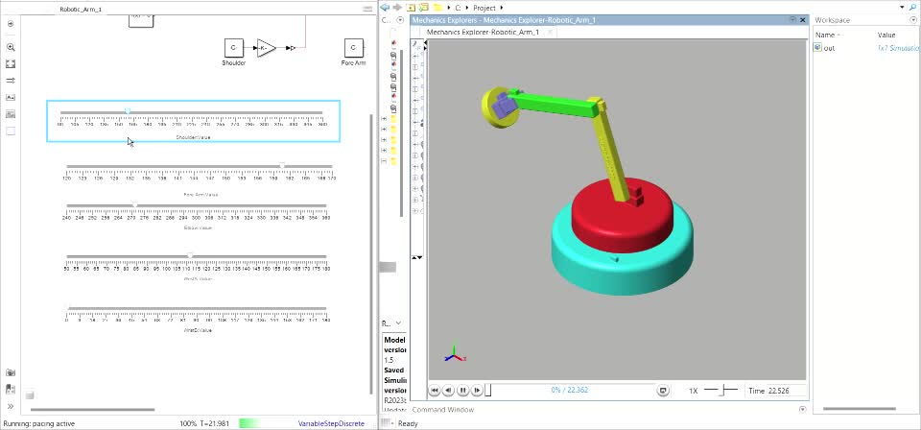
Visual Representation

Slide 10
Future work and Improvement
Kinematics Development:
Implement forward and inverse kinematics to control the robotic arm's joint angles for precise end-effector positioning.
Waypoint Strategy:
Develop a waypoint-based approach for trajectory planning to guide the arm through a series of target positions.
End-Effector Control:
Enhance control over the end-effector for accurate task
execution, such as reaching and manipulating objects

Slide 11
Conclusion
Project Overview: Successfully developed and simulated a 5-DOF robotic arm using MATLAB and Simulink, from design in SolidWorks to joint control.
Future Work: The project sets the stage for kinematics implementation, waypoint strategy development, and enhanced end-effector control.
Significance: Provides a foundation for advanced robotic arm control and practical robotics applications.

